Slide 1

SOBHA ACCEPTABLE QUALITY LEVEL (SAQL)
Document Title : | Silicon Application
Document Number : | SCL-SAQL-002
Date of Origin : | 08.05.2026
Date of Revision :
Revision Number : | 00
 | PREPARED BY | REVIEWED BY | REVIEWED BY | APPROVED BY | APPROVED BY | APPROVED BY | APPROVED BY
NAME | Mr. Deepan Shanmugavel | Mr. Rajeshkumar Lakshmanan | Mr. Thangapandi Rathinam | Mr. Suleyman Celik | Mr. Ayaz Siddiqui | Mr. Senthil Kumar Parasuraman | Mr. Karthikraj Rajendran
SIGNATURE
DATE

Slide 2
AMENDMENT SHEET
DATE OF REV | SUBJECT OF THE AMENDMENT | REV. NO.
08/05/2026 | New release | 00
2

Slide 3
OBJECTIVES
OBJECTIVE | The objective of this guideline is to provide a standard procedure for Silicon Application Acceptable levels according to the Zones.
SCOPE | This document is valid for Silicon Application Aesthetics Acceptance.
RESPONSIBLE | Site execution shall strictly adhere to the approved standards. QA/QC and QCS shall use these standards for inspection.
TERMS & REFERENCES | The QM / BE team shall be responsible for revising and updating the applicable standards as required.
3

Slide 4
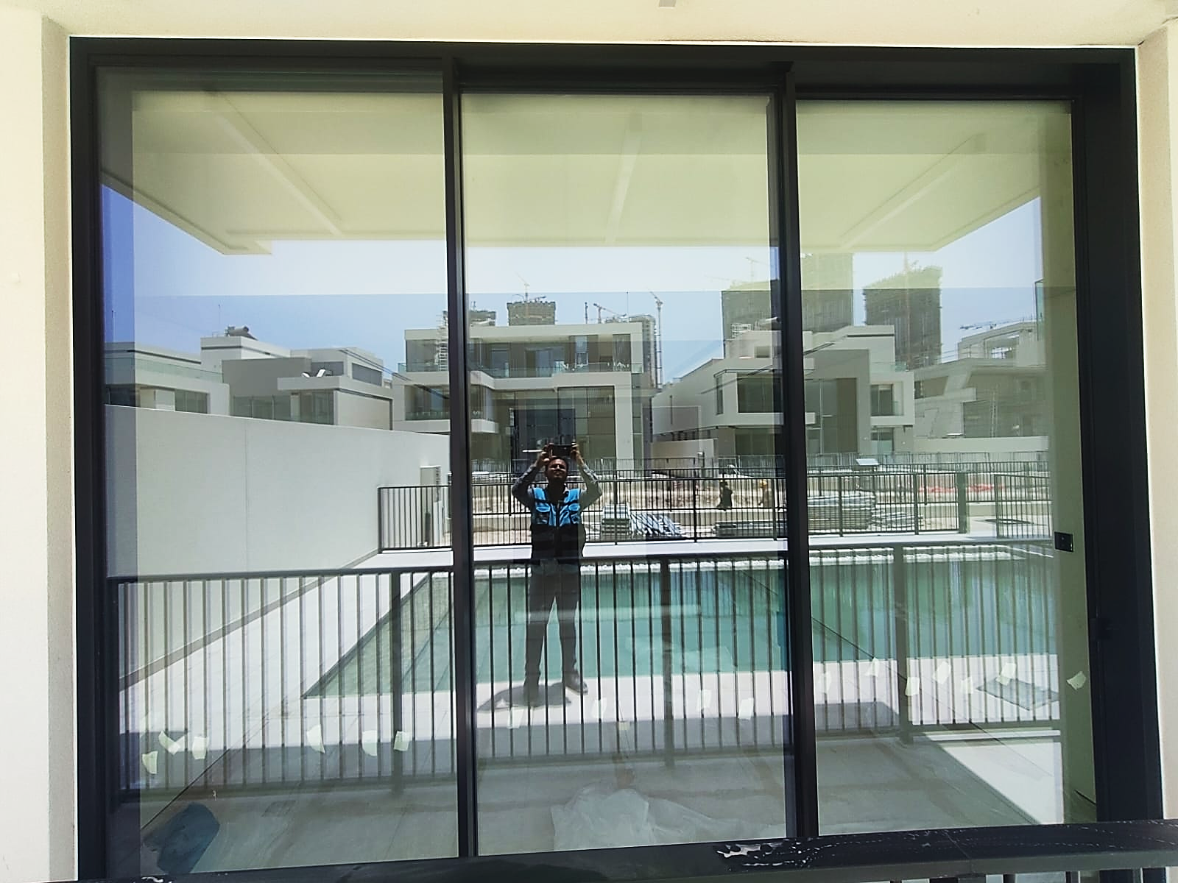
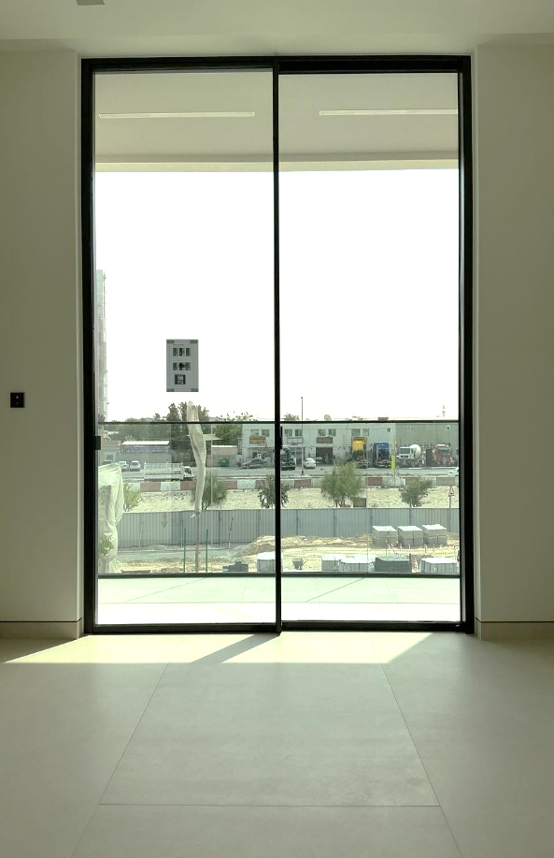
CATEGORIZATION / ZONES
Silicon – Façade Areas
Silicon Jamb External Facade
Silicon Jamb Internal Facade
Top
Top
Left
Right
Left
Right
Bottom
Bottom
Sobha Constructions LLC
4

Slide 5
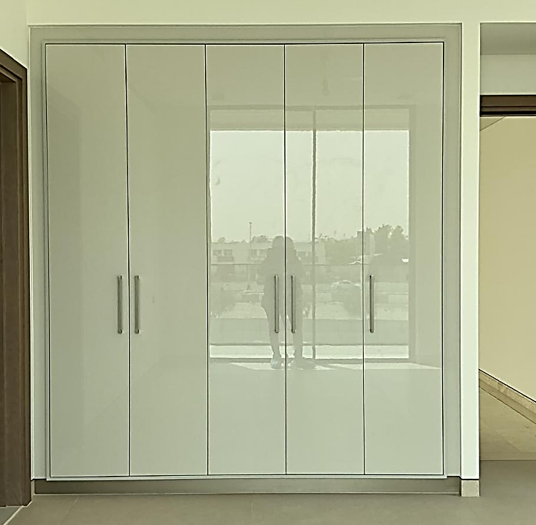
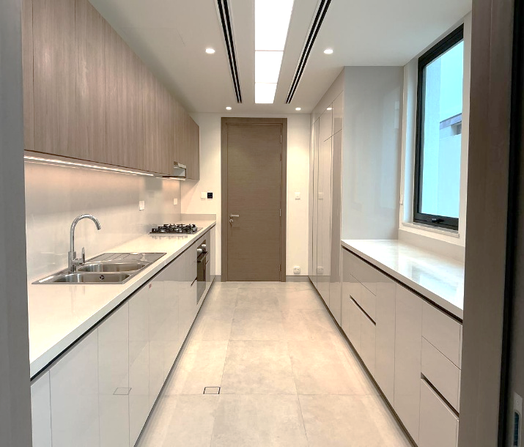
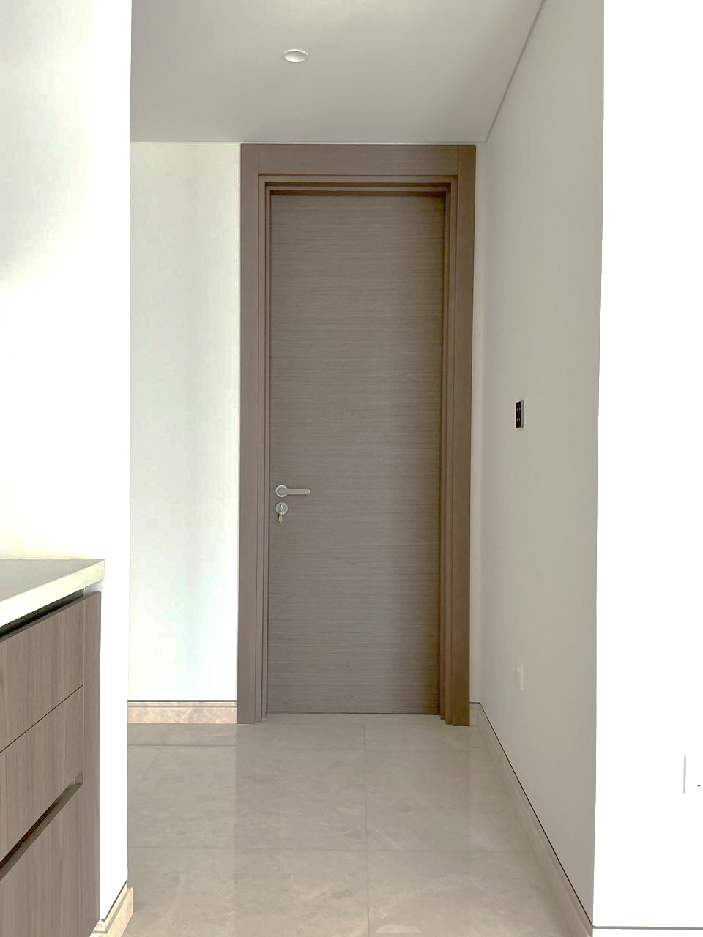
CATEGORIZATION / ZONES
Silicon – Joinery Areas
Wardrobe
Kitchen Cabinets
Door
Top
Top
Top
Left
Top
Right
Left
Right
Left
Right
Left
Right
Bottom
Bottom
Bottom
Sobha Constructions LLC
5

Slide 6
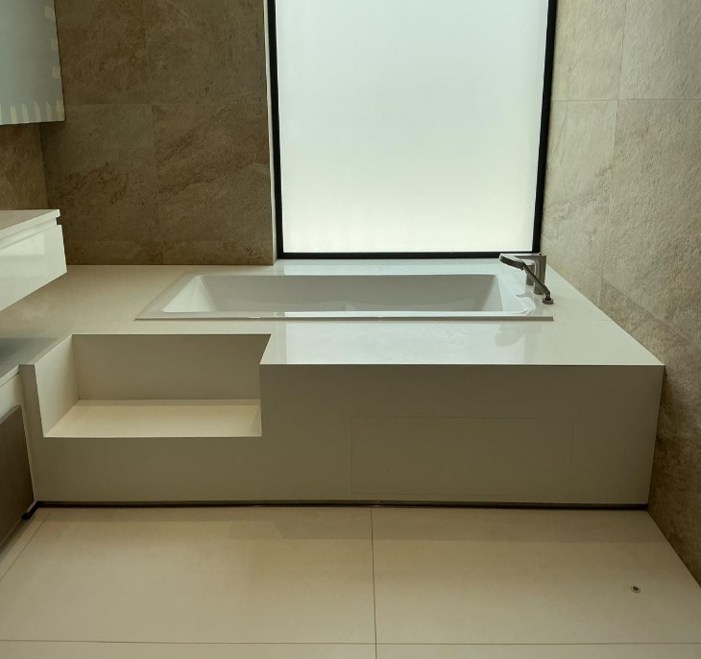
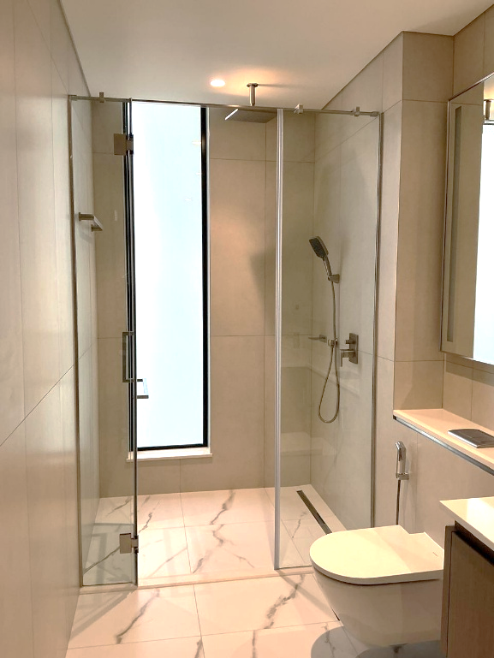
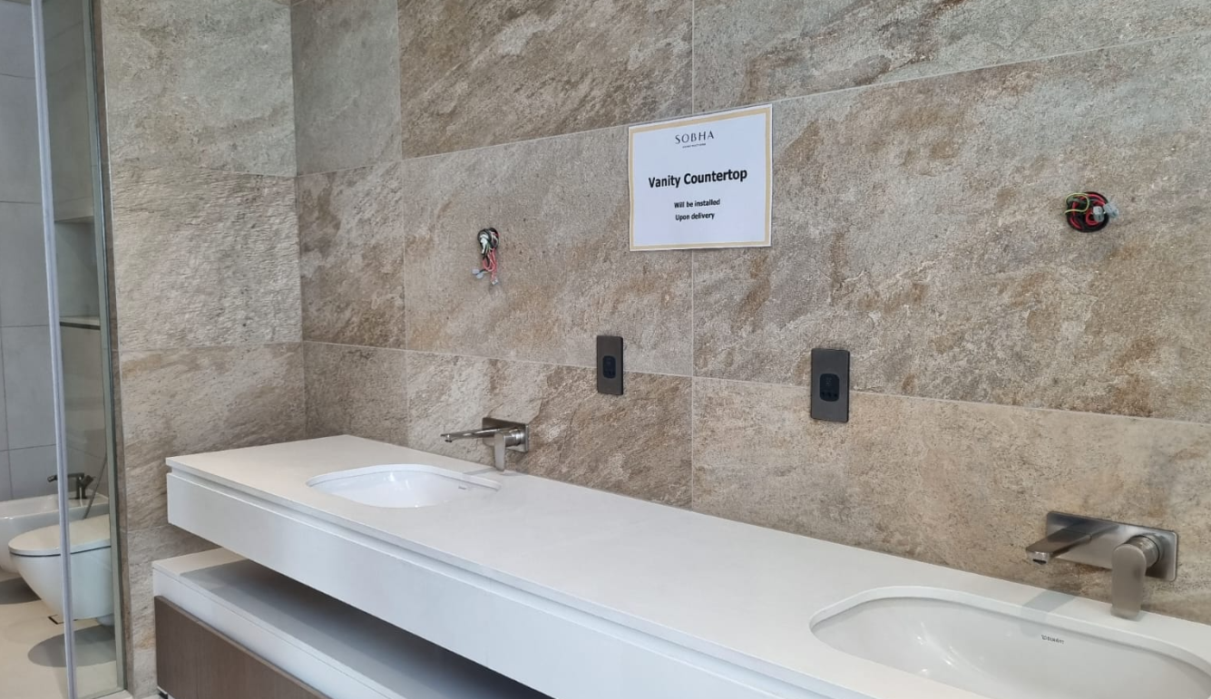
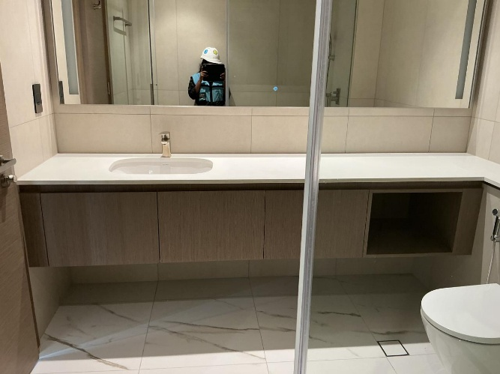
CATEGORIZATION / ZONES
Silicon – Sanitary Areas
Bath Tub
Shower Partition
Top
Left
Left
Right
Top
Right
Bottom
Bottom
Left
Top
Right
Vanity Countertop
Left
Sink and countertop bottom
Right
Top
Bottom
Bottom
Sobha Constructions LLC
6

Slide 7
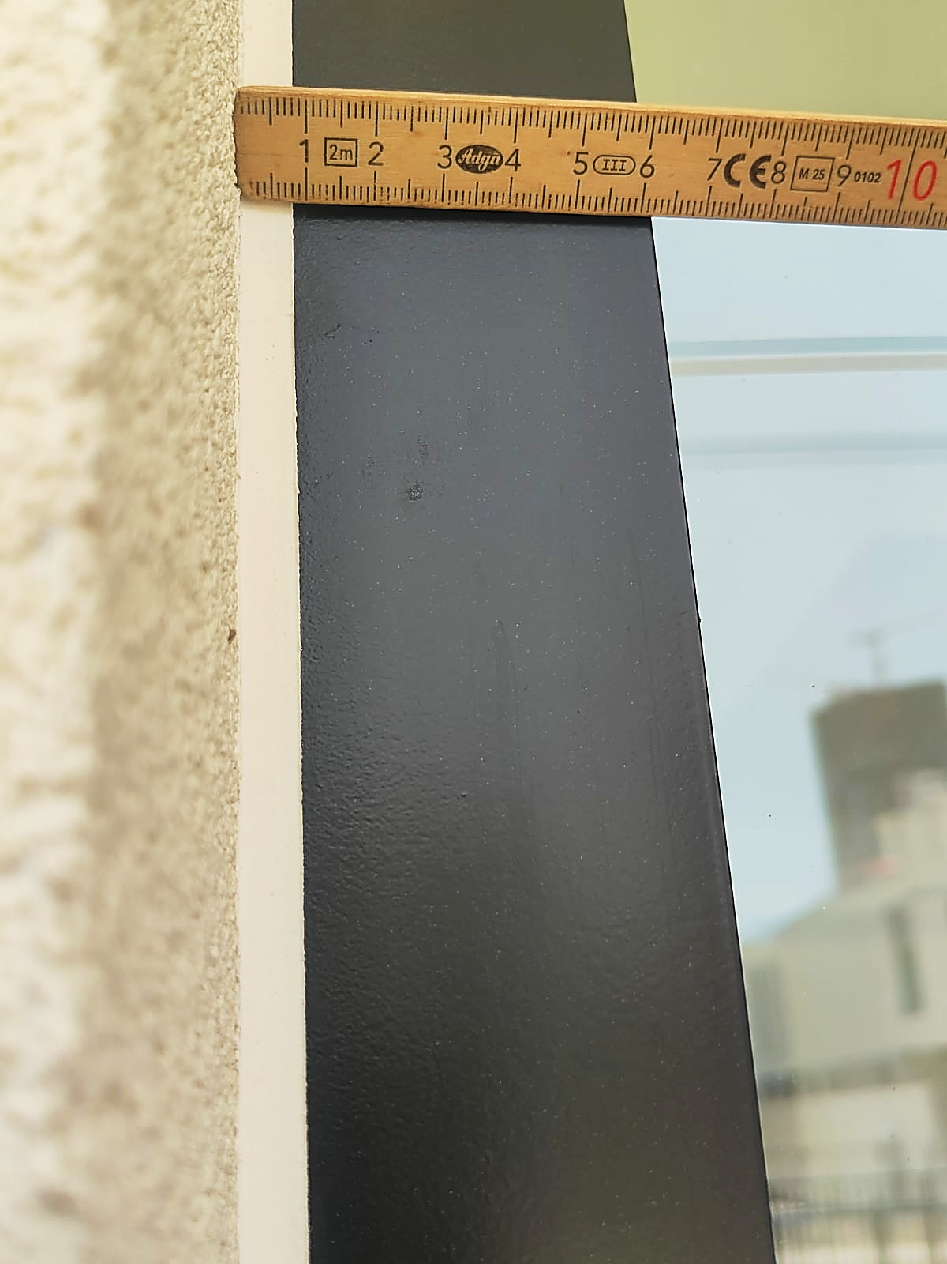
SILICON ACTIVITY - SAQL
DEFECT DESCRIPTION / PARAMETER |  |  |  | Silicon Uneven Thickness (Façade Area)
DEFECT IMAGE / PARAMTER |  |  |  | MEASURING METHOD
 |  |  |  | INSTRUMENT / INSPECTION METHOD |  |  | German scale | Direct visual Inspection
 |  |  |  | STANDING POSITION |  |  | As required
APPLICABILITY |  VILLA  APARTMENT |  |  | LIGHTING |  |  | Natural / Ambient light / Artificial Light
ACCEPTABLE QUALITY LEVEL
SCENARIO / LOCATION / ZONE | Internal Jamb |  |  |  | External Jamb
 | Top | Bottom | Right | Left | Top | Bottom |  | Right | Left
ACCEPTANCE LIMIT | Width :6,7,8,9,10 mm Allowed. Difference Between Side: Max 1mm Straighness:0mm on single side. | Width :6,7,8,9,10 mm Allowed. Difference Between Side: Max 1mm Straighness:0mm on single side. | Width :6,7,8,9,10 mm Allowed. Difference Between Side: Max 1mm Straighness:0mm on single side. | Width :6,7,8,9,10 mm Allowed. Difference Between Side: Max 1mm Straighness:0mm on single side. | Width :6,7,8,9,10 mm Allowed. Difference Between Side: Max 1mm Straighness:0mm on single side. | Width :6,7,8,9,10 mm Allowed. Difference Between Side: Max 1mm Straighness:0mm on single side. |  | Width :6,7,8,9,10 mm Allowed. Difference Between Side: Max 1mm Straighness:0mm on single side. | Width :6,7,8,9,10 mm Allowed. Difference Between Side: Max 1mm Straighness:0mm on single side.
REMARKS | Example : Left Side clearance shall be 7mm, and Right-Side clearance shall be 8,9mm.
Place the German scale flat against the wall end, ensuring it is properly seated.
Measure the thickness/offset up to the facade end by reading the scale at the contact point.
Measure the thickness and verify it against the specified tolerance.
“Note: During keep-out inspection in case of any visual discrepancy identified, measurement verification shall be carried out based on the SAQL.”
Sobha Constructions LLC
7

Slide 8
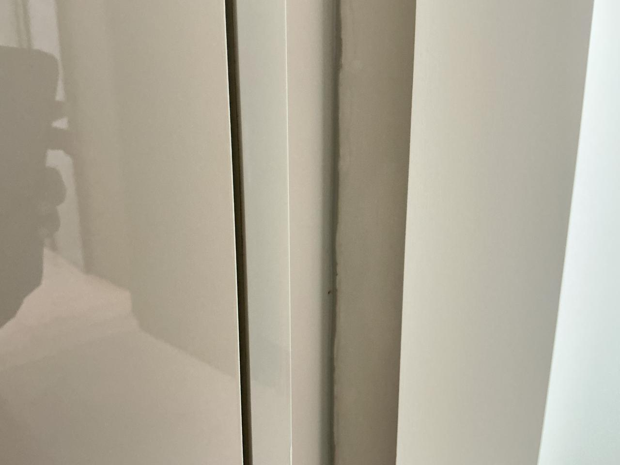
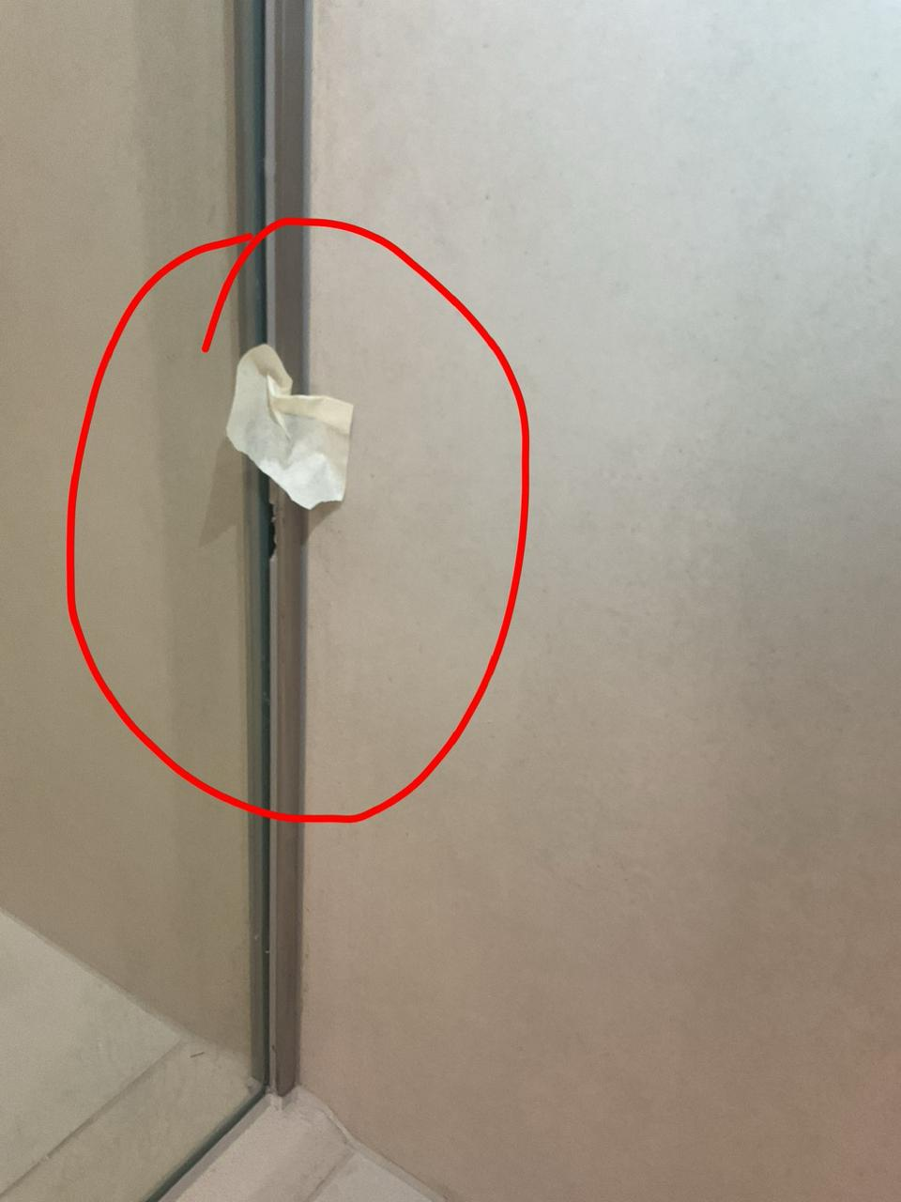
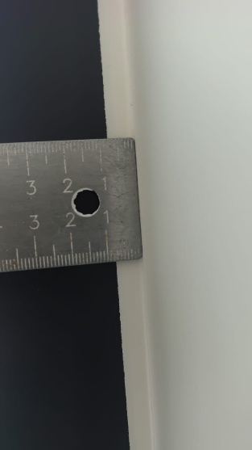
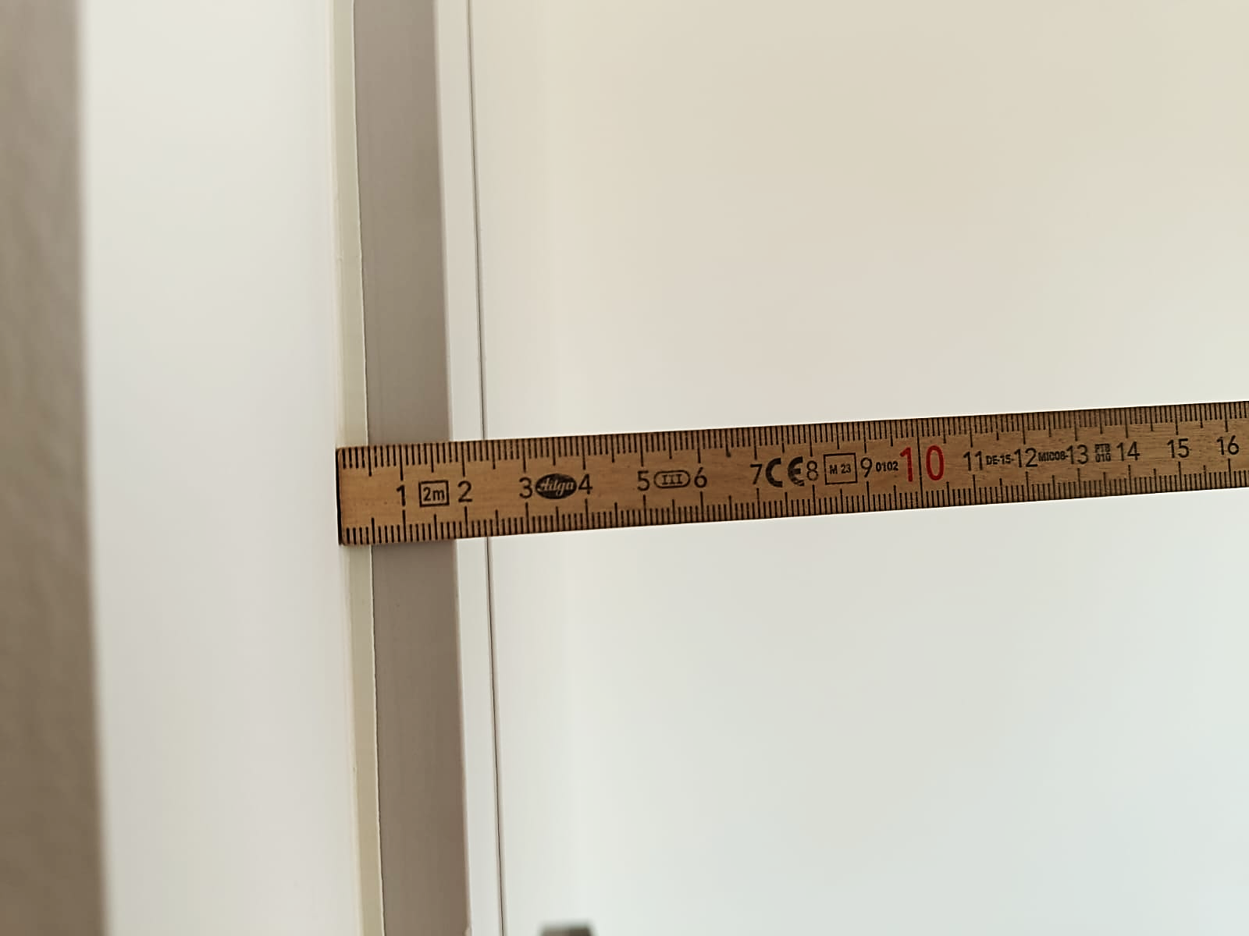
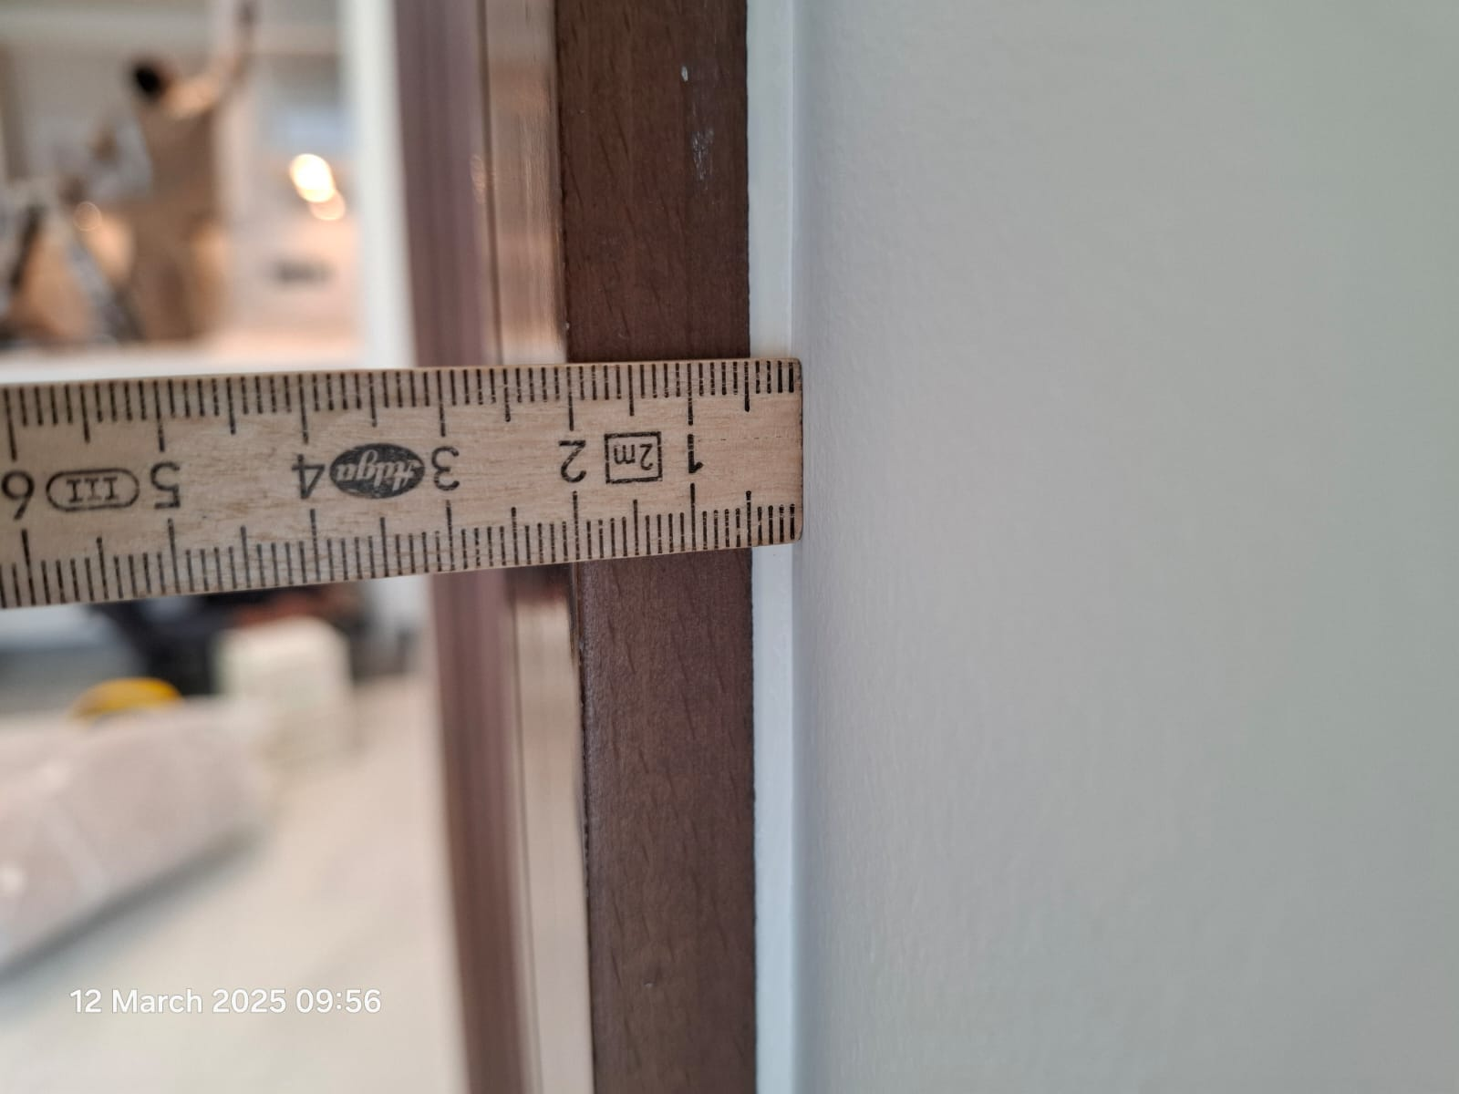
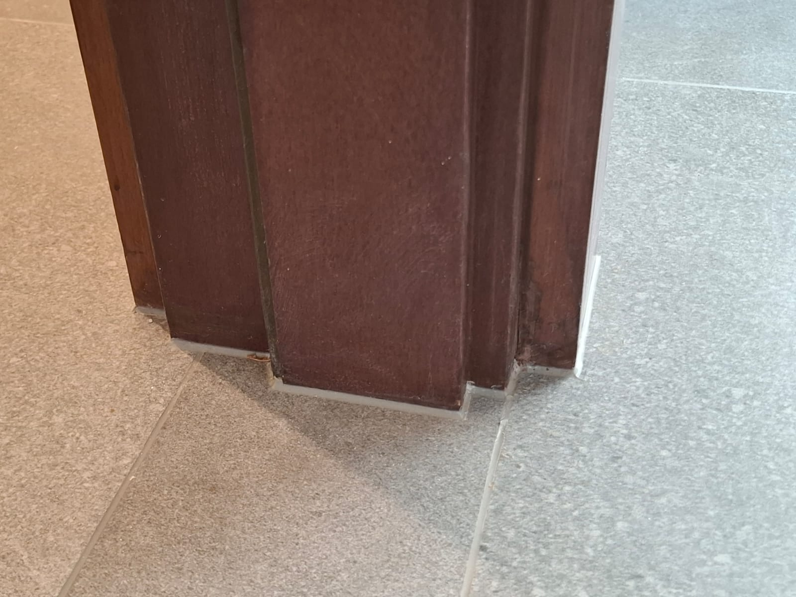
SILICON ACTIVITY - SAQL
DEFECT DESCRIPTION / PARAMETER |  |  |  |  |  |  | Silicon Uneven Thickness (Joinery Area)
DEFECT IMAGE / PARAMTER |  |  |  |  |  |  | MEASURING METHOD
 |  |  |  |  |  |  | INSTRUMENT / INSPECTION METHOD |  |  |  | German scale |  | Direct visual Inspection
 |  |  |  |  |  |  | STANDING POSITION |  |  |  | As required
APPLICABILITY |  |  VILLA  APARTMENT |  |  |  |  | LIGHTING |  |  |  | Natural / Ambient light / Artificial Light
ACCEPTABLE QUALITY LEVEL
SCENARIO / LOCATION / ZONE | All Wardrobe | All Wardrobe |  |  |  | All Kitchen Cabinets |  |  |  |  |  | All Doors
 | Top | Top | Bottom | Right | Left | Top |  | Bottom | Right | Left |  | Top | Bottom | Right | Left
ACCEPTANCE LIMIT | Width: 3,4mm Straightness: 0mm on single side. | Width: 3mm (+1/-0mm) Straighness:0mm on single side. | Width: 3,4mm Straightness: 0mm on single side. | Width: 3,4mm Straightness: 0mm on single side. | Width: 3,4mm Straightness: 0mm on single side. | Width: 3,4mm Straightness: 0mm on single side. |  | Width: 3,4mm Straightness: 0mm on single side. | Width: 3,4mm Straightness: 0mm on single side. | Width: 3,4mm Straightness: 0mm on single side. |  | Width: 3,4mm Straightness: 0mm on single side. | Width: 3,4mm Straightness: 0mm on single side. | Width: 3,4mm Straightness: 0mm on single side. | Width: 3,4mm Straightness: 0mm on single side.
REMARKS
Place the German scale flat against the wall end, ensuring it is properly seated.
Measure the thickness of the silicon
Verify it against the specified tolerance.
“Note: During keep-out inspection in case of any visual discrepancy identified, measurement verification shall be carried out based on the SAQL.”
Sobha Constructions LLC
8

Slide 9
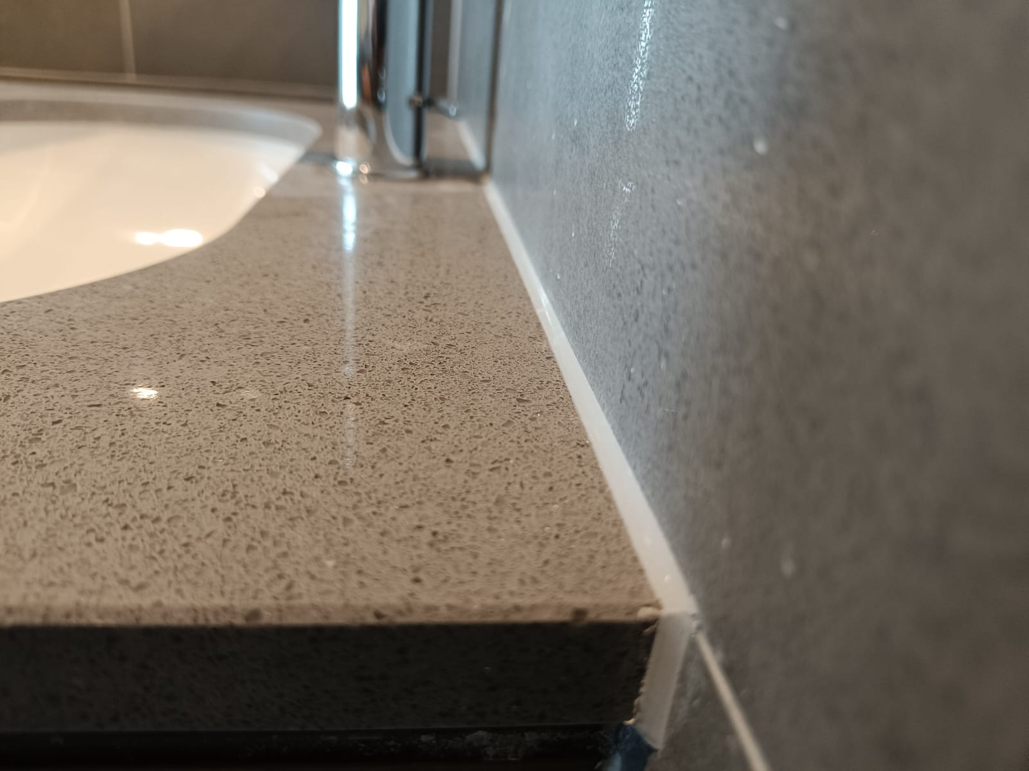
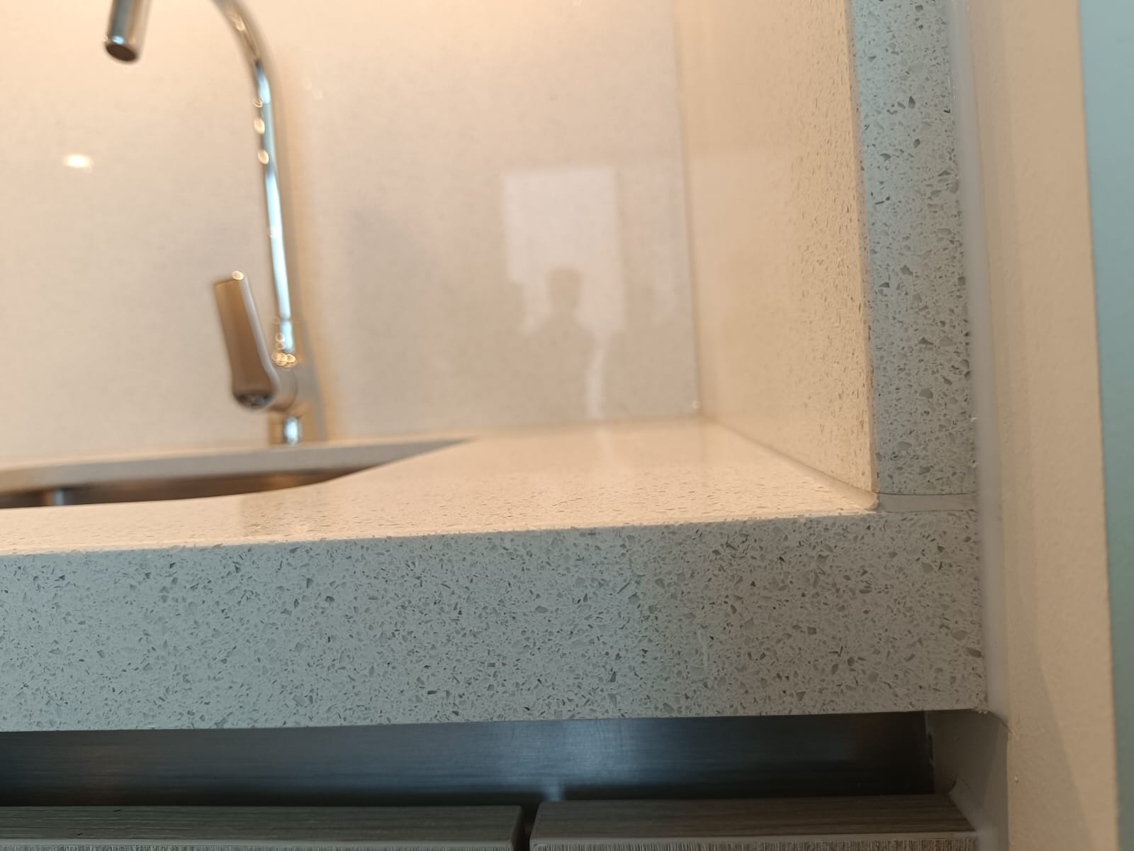
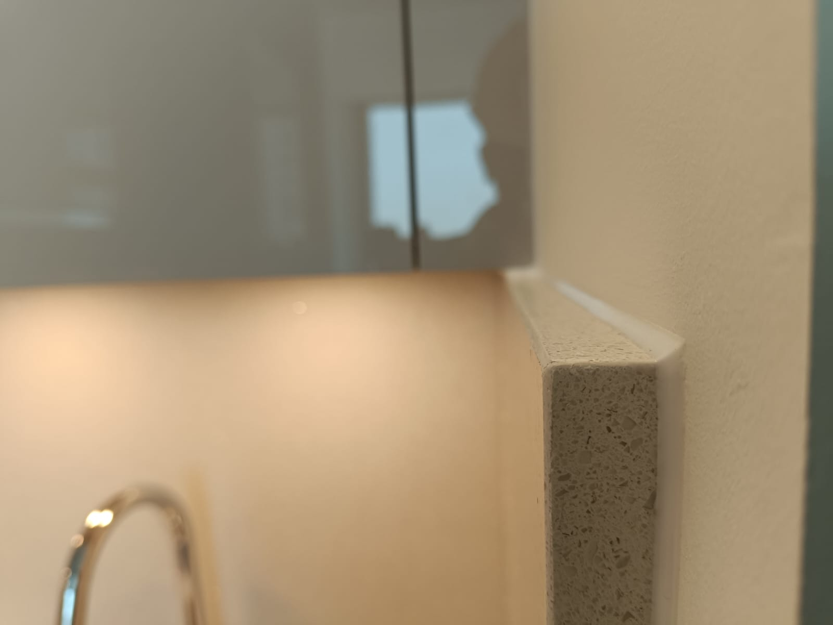
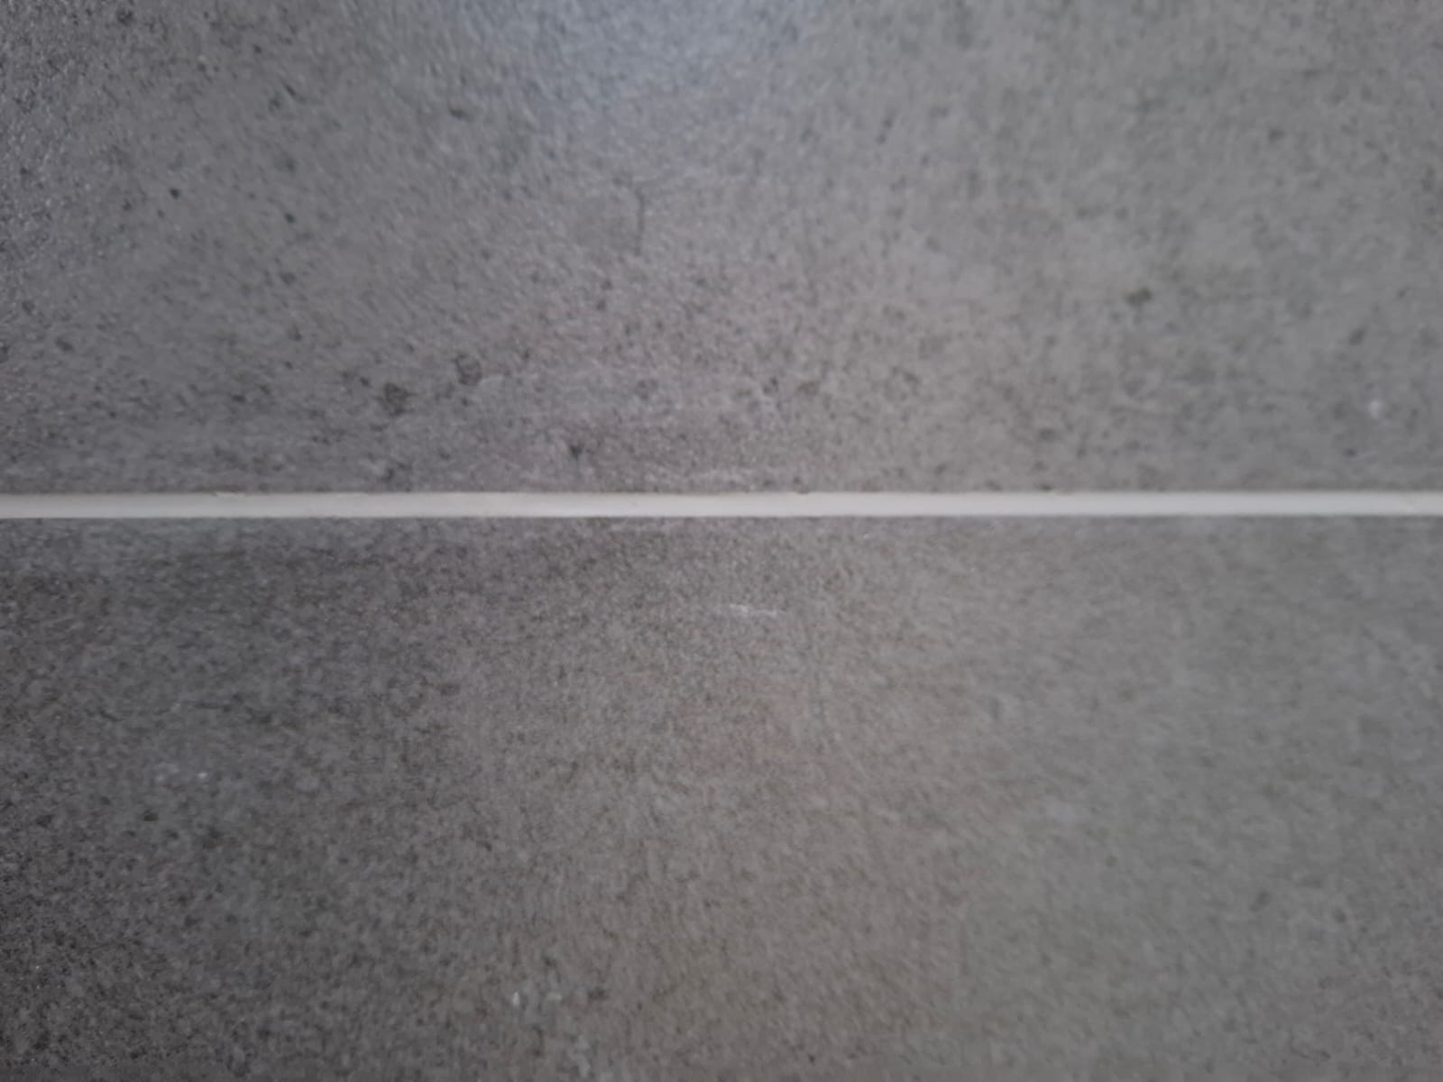
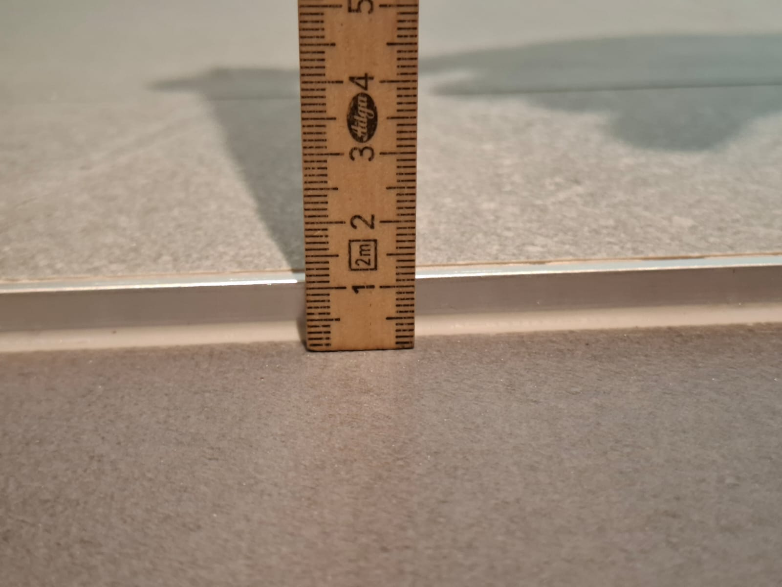
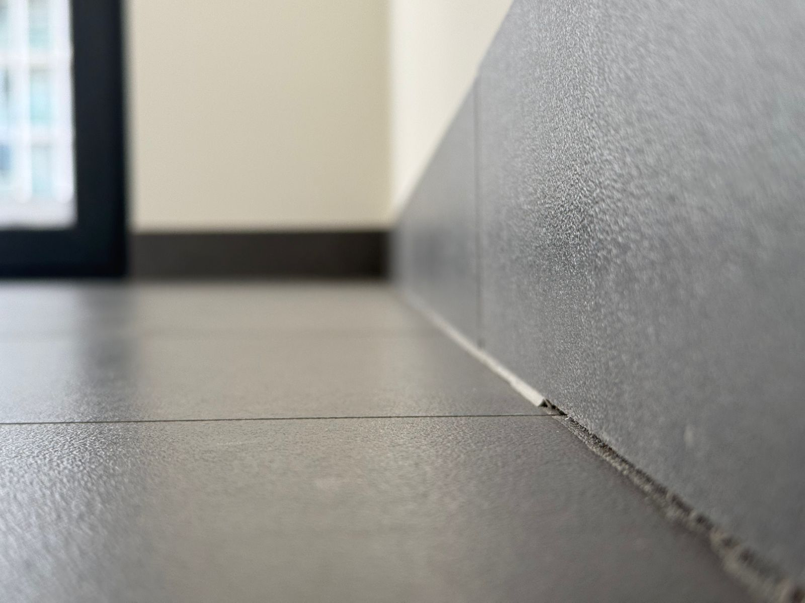
SILICON ACTIVITY - SAQL
DEFECT DESCRIPTION / PARAMETER |  |  |  |  |  |  |  |  | Silicon Uneven Thickness (Sanitary Area)
DEFECT IMAGE / PARAMTER |  |  |  |  |  |  |  |  | MEASURING METHOD
 |  |  |  |  |  |  |  |  | INSTRUMENT / INSPECTION METHOD |  |  |  |  | German scale
 |  |  |  |  |  |  |  |  | STANDING POSITION |  |  |  |  | As required
APPLICABILITY |  |  VILLA  APARTMENT |  |  |  |  |  |  | LIGHTING |  |  |  |  | Natural / Ambient light / Artificial Light
ACCEPTABLE QUALITY LEVEL
SCENARIO / LOCATION / ZONE | Bath Tub & Shower Partition | Bath Tub |  |  |  | Vanity Countertop & Sink Bottom |  |  |  |  | Tile Vs Skirting |  |  |  |  | Control Joint(Floor Tile)
 | Top | Top | Bottom | Right | Left | Top | Bottom | Right |  | Left | Top | Bottom | Right |  | Left | Top | Bottom | Right | Left
ACCEPTANCE LIMIT | Width: 3,4mm Straightness: 0mm on single side. | Width: 3mm (+1/-0mm) Straightness: 0mm on single side. | Width: 3,4mm Straightness: 0mm on single side. | Width: 3,4mm Straightness: 0mm on single side. | Width: 3,4mm Straightness: 0mm on single side. | Width: 3,4mm Straightness: 0mm on single side. | Width: 3,4mm Straightness: 0mm on single side. | Width: 3,4mm Straightness: 0mm on single side. |  | Width: 3,4mm Straightness: 0mm on single side. | NA | Width: 4.8,4.9,5,5.1,5.2mm Straightness: 0mm on single side. | NA |  | NA | NA | Width: 1.3,1.4,1.5,1.6,1.7 mm Straightness: 0mm on single side. | NA | NA
REMARKS
Place the German scale flat against the wall end, ensuring it is properly seated.
Measure the thickness of the silicon
Verify it against the specified tolerance.
“Note: During keep-out inspection in case of any visual discrepancy identified, measurement verification shall be carried out based on the SAQL.”
Sobha Constructions LLC
9

Slide 10
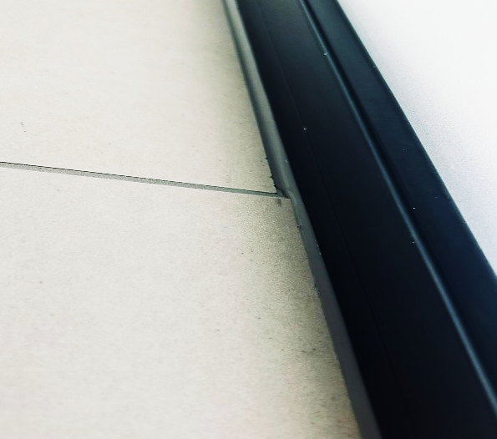
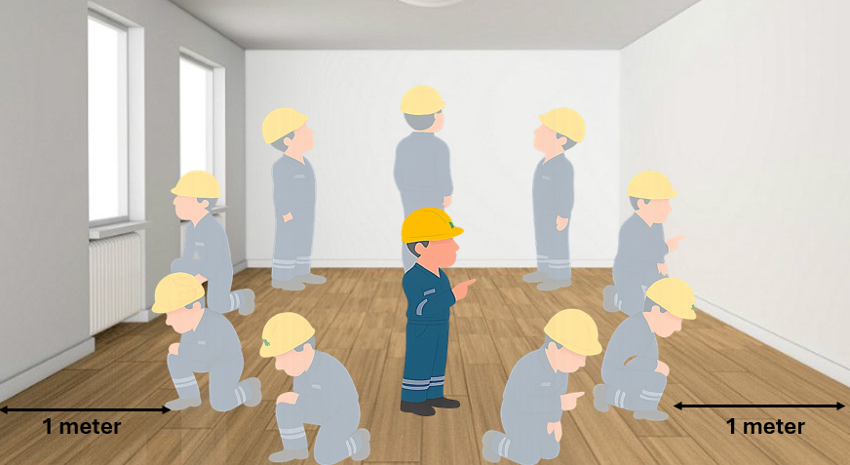
SILICON ACTIVITY - SAQL
DEFECT DESCRIPTION / PARAMETER |  |  |  |  |  |  | Uneven Silicone application
DEFECT IMAGE / PARAMTER |  |  |  |  |  |  | MEASURING METHOD
 |  |  |  |  |  |  | INSTRUMENT / INSPECTION METHOD |  |  |  |  |  | Visual Inspection
 |  |  |  |  |  |  | STANDING POSITION |  |  |  |  |  | Minimum 1 Meter in any direction.
APPLICABILITY |  VILLA  APARTMENT |  |  |  |  |  | LIGHTING |  |  |  |  |  | Natural / Ambient light / Artificial Light
ACCEPTABLE QUALITY LEVEL
SCENARIO / LOCATION / ZONE | Façade – Internal Jamb |  |  |  | Façade – External Jamb |  |  |  |  | Joinery |  |  |  |  | Sanitary
 | Top | Bottom | Right | Left | Top | Bottom |  | Right | Left | Top | Bottom | Right |  | Left | Top | Bottom | Right | Left
ACCEPTANCE LIMIT | Not allowed |  |  |  | Not allowed |  |  |  |  | Not allowed |  |  |  |  | Not allowed
REMARKS
Visual inspection of painted areas shall be carried out under natural daylight or appropriate artificial lighting from all relevant directions.
“Note: During keep-out inspection in case of any visual discrepancy identified, measurement verification shall be carried out based on the SAQL.”
10

Slide 11
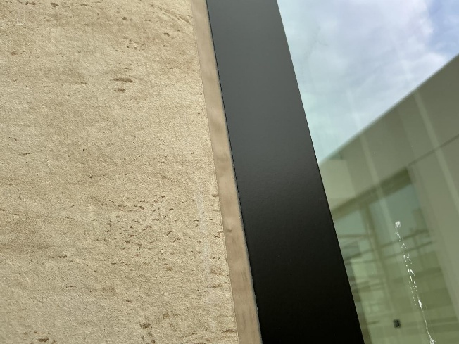
SILICON ACTIVITY - SAQL
DEFECT DESCRIPTION / PARAMETER |  |  |  |  |  |  | Silicone Undulations
DEFECT IMAGE / PARAMTER |  |  |  |  |  |  | MEASURING METHOD
 |  |  |  |  |  |  | INSTRUMENT / INSPECTION METHOD |  |  |  |  |  | Visual Inspection
 |  |  |  |  |  |  | STANDING POSITION |  |  |  |  |  | Minimum 1 Meter in any direction.
APPLICABILITY |  VILLA  APARTMENT |  |  |  |  |  | LIGHTING |  |  |  |  |  | Natural / Ambient light / Artificial Light
ACCEPTABLE QUALITY LEVEL
SCENARIO / LOCATION / ZONE | Façade – Internal Jamb |  |  |  | Façade – External Jamb |  |  |  |  | Joinery |  |  |  |  | Sanitary
 | Top | Bottom | Right | Left | Top | Bottom |  | Right | Left | Top | Bottom | Right |  | Left | Top | Bottom | Right | Left
ACCEPTANCE LIMIT | Not allowed |  |  |  | Not allowed |  |  |  |  | Not allowed |  |  |  |  | Not allowed
REMARKS
Visual inspection of painted areas shall be carried out under natural daylight or appropriate artificial lighting from all relevant directions.
“Note: During keep-out inspection in case of any visual discrepancy identified, measurement verification shall be carried out based on the SAQL.”
11

Slide 12
SILICON ACTIVITY - SAQL
DEFECT DESCRIPTION / PARAMETER |  |  |  |  |  |  | Silicone damage
DEFECT IMAGE / PARAMTER |  |  |  |  |  |  | MEASURING METHOD
 |  |  |  |  |  |  | INSTRUMENT / INSPECTION METHOD |  |  |  |  |  | Visual Inspection
 |  |  |  |  |  |  | STANDING POSITION |  |  |  |  |  | Minimum 1 Meter in any direction.
APPLICABILITY |  VILLA  APARTMENT |  |  |  |  |  | LIGHTING |  |  |  |  |  | Natural / Ambient light / Artificial Light
ACCEPTABLE QUALITY LEVEL
SCENARIO / LOCATION / ZONE | Façade – Internal Jamb |  |  |  | Façade – External Jamb |  |  |  |  | Joinery |  |  |  |  | Sanitary
 | Top | Bottom | Right | Left | Top | Bottom |  | Right | Left | Top | Bottom | Right |  | Left | Top | Bottom | Right | Left
ACCEPTANCE LIMIT | Not allowed |  |  |  | Not allowed |  |  |  |  | Not allowed |  |  |  |  | Not allowed
REMARKS
Visual inspection of painted areas shall be carried out under natural daylight or appropriate artificial lighting from all relevant directions.
“Note: During keep-out inspection in case of any visual discrepancy identified, measurement verification shall be carried out based on the SAQL.”
12

Slide 13
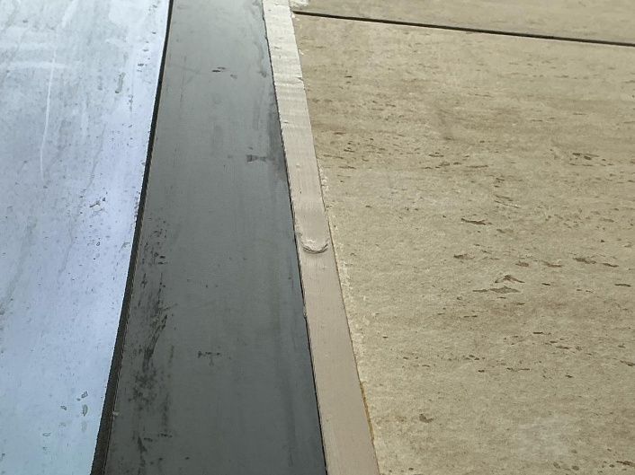
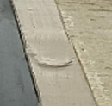
SILICON ACTIVITY - SAQL
DEFECT DESCRIPTION / PARAMETER |  |  |  |  |  |  | Silicone rough finish
DEFECT IMAGE / PARAMTER |  |  |  |  |  |  | MEASURING METHOD
 |  |  |  |  |  |  | INSTRUMENT / INSPECTION METHOD |  |  |  |  |  | Visual Inspection
 |  |  |  |  |  |  | STANDING POSITION |  |  |  |  |  | Minimum 1 Meter in any direction.
APPLICABILITY |  VILLA  APARTMENT |  |  |  |  |  | LIGHTING |  |  |  |  |  | Natural / Ambient light / Artificial Light
ACCEPTABLE QUALITY LEVEL
SCENARIO / LOCATION / ZONE | Façade – Internal Jamb |  |  |  | Façade – External Jamb |  |  |  |  | Joinery |  |  |  |  | Sanitary
 | Top | Bottom | Right | Left | Top | Bottom |  | Right | Left | Top | Bottom | Right |  | Left | Top | Bottom | Right | Left
ACCEPTANCE LIMIT | Not allowed |  |  |  | Not allowed |  |  |  |  | Not allowed |  |  |  |  | Not allowed
REMARKS
Visual inspection of painted areas shall be carried out under natural daylight or appropriate artificial lighting from all relevant directions.
“Note: During keep-out inspection in case of any visual discrepancy identified, measurement verification shall be carried out based on the SAQL.”
13

Slide 14
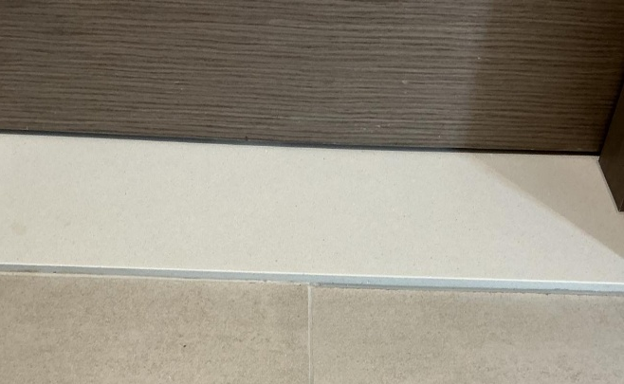
SILICON ACTIVITY - SAQL
DEFECT DESCRIPTION / PARAMETER |  |  |  |  |  |  | Silicone shade variation
DEFECT IMAGE / PARAMTER |  |  |  |  |  |  | MEASURING METHOD
 |  |  |  |  |  |  | INSTRUMENT / INSPECTION METHOD |  |  |  |  |  | Visual Inspection
 |  |  |  |  |  |  | STANDING POSITION |  |  |  |  |  | Minimum 1 Meter in any direction.
APPLICABILITY |  VILLA  APARTMENT |  |  |  |  |  | LIGHTING |  |  |  |  |  | Natural / Ambient light / Artificial Light
ACCEPTABLE QUALITY LEVEL
SCENARIO / LOCATION / ZONE | Façade – Internal Jamb |  |  |  | Façade – External Jamb |  |  |  |  | Joinery |  |  |  |  | Sanitary
 | Top | Bottom | Right | Left | Top | Bottom |  | Right | Left | Top | Bottom | Right |  | Left | Top | Bottom | Right | Left
ACCEPTANCE LIMIT | Not allowed |  |  |  | Not allowed |  |  |  |  | Not allowed |  |  |  |  | Not allowed
REMARKS
Visual inspection of painted areas shall be carried out under natural daylight or appropriate artificial lighting from all relevant directions.
“Note: During keep-out inspection in case of any visual discrepancy identified, measurement verification shall be carried out based on the SAQL.”
14

Slide 15
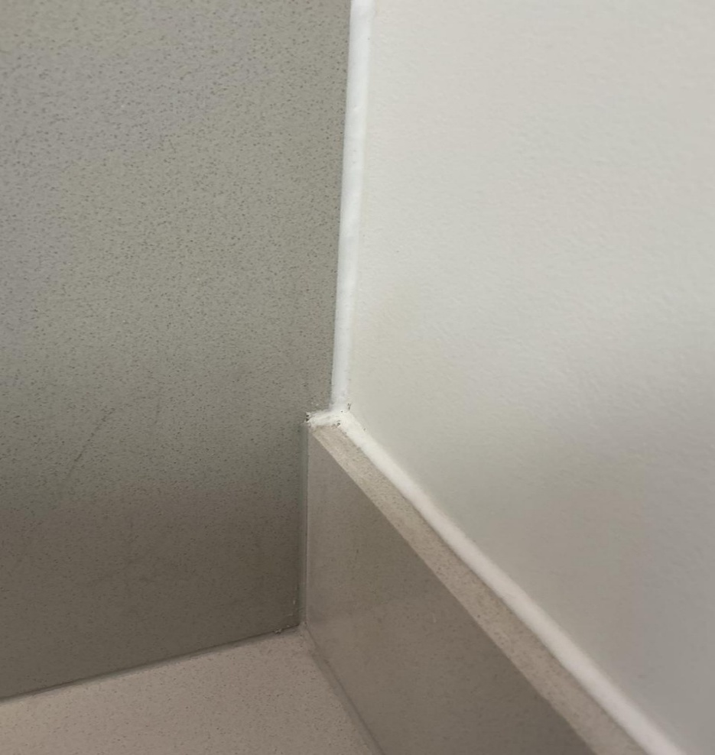
SILICON ACTIVITY - SAQL
DEFECT DESCRIPTION / PARAMETER |  |  |  |  |  |  | Uneven termination
DEFECT IMAGE / PARAMTER |  |  |  |  |  |  | MEASURING METHOD
 |  |  |  |  |  |  | INSTRUMENT / INSPECTION METHOD |  |  |  |  |  | Visual Inspection
 |  |  |  |  |  |  | STANDING POSITION |  |  |  |  |  | Minimum 1 Meter in any direction.
APPLICABILITY |  VILLA  APARTMENT |  |  |  |  |  | LIGHTING |  |  |  |  |  | Natural / Ambient light / Artificial Light
ACCEPTABLE QUALITY LEVEL
SCENARIO / LOCATION / ZONE | Façade – Internal Jamb |  |  |  | Façade – External Jamb |  |  |  |  | Joinery |  |  |  |  | Sanitary
 | Top | Bottom | Right | Left | Top | Bottom |  | Right | Left | Top | Bottom | Right |  | Left | Top | Bottom | Right | Left
ACCEPTANCE LIMIT | Not allowed |  |  |  | Not allowed |  |  |  |  | Not allowed |  |  |  |  | Not allowed
REMARKS
Visual inspection of painted areas shall be carried out under natural daylight or appropriate artificial lighting from all relevant directions.
“Note: During keep-out inspection in case of any visual discrepancy identified, measurement verification shall be carried out based on the SAQL.”
15

Slide 16
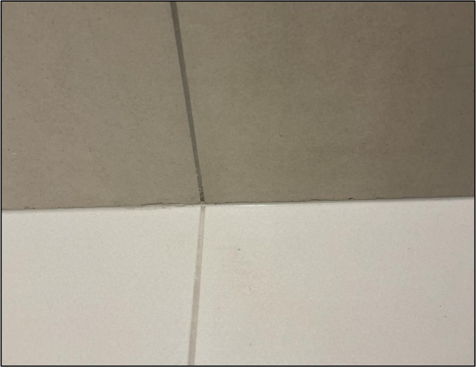
SILICON ACTIVITY - SAQL
DEFECT DESCRIPTION / PARAMETER |  |  |  |  |  |  | Silicone peel-off
DEFECT IMAGE / PARAMTER |  |  |  |  |  |  | MEASURING METHOD
 |  |  |  |  |  |  | INSTRUMENT / INSPECTION METHOD |  |  |  |  |  | Visual Inspection
 |  |  |  |  |  |  | STANDING POSITION |  |  |  |  |  | Minimum 1 Meter in any direction.
APPLICABILITY |  VILLA  APARTMENT |  |  |  |  |  | LIGHTING |  |  |  |  |  | Natural / Ambient light / Artificial Light
ACCEPTABLE QUALITY LEVEL
SCENARIO / LOCATION / ZONE | Façade – Internal Jamb |  |  |  | Façade – External Jamb |  |  |  |  | Joinery |  |  |  |  | Sanitary
 | Top | Bottom | Right | Left | Top | Bottom |  | Right | Left | Top | Bottom | Right |  | Left | Top | Bottom | Right | Left
ACCEPTANCE LIMIT | Not allowed |  |  |  | Not allowed |  |  |  |  | Not allowed |  |  |  |  | Not allowed
REMARKS
Visual inspection of painted areas shall be carried out under natural daylight or appropriate artificial lighting from all relevant directions.
“Note: During keep-out inspection in case of any visual discrepancy identified, measurement verification shall be carried out based on the SAQL.”
16

Slide 17
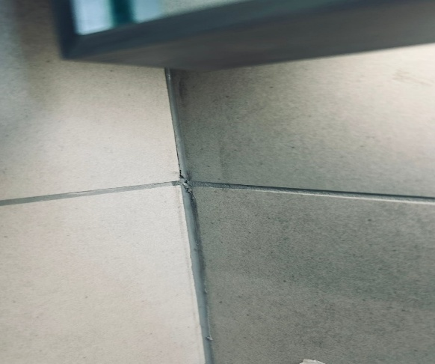
SILICON ACTIVITY - SAQL
DEFECT DESCRIPTION / PARAMETER |  |  |  |  |  |  | Silicone Discontinuous
DEFECT IMAGE / PARAMTER |  |  |  |  |  |  | MEASURING METHOD
 |  |  |  |  |  |  | INSTRUMENT / INSPECTION METHOD |  |  |  |  |  | Visual Inspection
 |  |  |  |  |  |  | STANDING POSITION |  |  |  |  |  | Minimum 1 Meter in any direction.
APPLICABILITY |  VILLA  APARTMENT |  |  |  |  |  | LIGHTING |  |  |  |  |  | Natural / Ambient light / Artificial Light
ACCEPTABLE QUALITY LEVEL
SCENARIO / LOCATION / ZONE | Façade – Internal Jamb |  |  |  | Façade – External Jamb |  |  |  |  | Joinery |  |  |  |  | Sanitary
 | Top | Bottom | Right | Left | Top | Bottom |  | Right | Left | Top | Bottom | Right |  | Left | Top | Bottom | Right | Left
ACCEPTANCE LIMIT | Not allowed |  |  |  | Not allowed |  |  |  |  | Not allowed |  |  |  |  | Not allowed
REMARKS
Visual inspection of painted areas shall be carried out under natural daylight or appropriate artificial lighting from all relevant directions.
“Note: During keep-out inspection in case of any visual discrepancy identified, measurement verification shall be carried out based on the SAQL.”
17

Slide 18
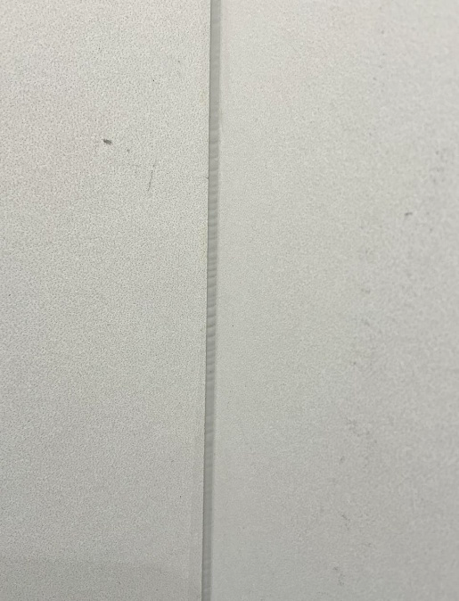
SILICON ACTIVITY - SAQL
DEFECT DESCRIPTION / PARAMETER |  |  |  |  |  |  | Silicon Bubble formation
DEFECT IMAGE / PARAMTER |  |  |  |  |  |  | MEASURING METHOD
 |  |  |  |  |  |  | INSTRUMENT / INSPECTION METHOD |  |  |  |  |  | Visual Inspection
 |  |  |  |  |  |  | STANDING POSITION |  |  |  |  |  | Minimum 1 Meter in any direction.
APPLICABILITY |  VILLA  APARTMENT |  |  |  |  |  | LIGHTING |  |  |  |  |  | Natural / Ambient light / Artificial Light
ACCEPTABLE QUALITY LEVEL
SCENARIO / LOCATION / ZONE | Façade – Internal Jamb |  |  |  | Façade – External Jamb |  |  |  |  | Joinery |  |  |  |  | Sanitary
 | Top | Bottom | Right | Left | Top | Bottom |  | Right | Left | Top | Bottom | Right |  | Left | Top | Bottom | Right | Left
ACCEPTANCE LIMIT | Not allowed |  |  |  | Not allowed |  |  |  |  | Not allowed |  |  |  |  | Not allowed
REMARKS
Visual inspection of painted areas shall be carried out under natural daylight or appropriate artificial lighting from all relevant directions.
“Note: During keep-out inspection in case of any visual discrepancy identified, measurement verification shall be carried out based on the SAQL.”
18

Slide 19
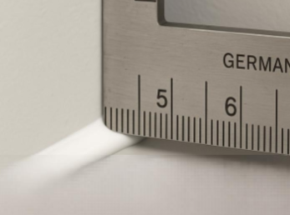
SILICON ACTIVITY - SAQL
DEFECT DESCRIPTION / PARAMETER |  |  |  |  |  |  | Silicon Not in Line (Straightness)
DEFECT IMAGE / PARAMTER |  |  |  |  |  |  | MEASURING METHOD
 |  |  |  |  |  |  | INSTRUMENT / INSPECTION METHOD |  |  |  |  |  | German Scale
 |  |  |  |  |  |  | STANDING POSITION |  |  |  |  |  | As required
APPLICABILITY |  VILLA  APARTMENT |  |  |  |  |  | LIGHTING |  |  |  |  |  | Natural / Ambient light / Artificial Light
ACCEPTABLE QUALITY LEVEL
SCENARIO / LOCATION / ZONE | Façade – Internal Jamb |  |  |  | Façade – External Jamb |  |  |  |  | Joinery |  |  |  |  | Sanitary
 | Top | Bottom | Right | Left | Top | Bottom |  | Right | Left | Top | Bottom | Right |  | Left | Top | Bottom | Right | Left
ACCEPTANCE LIMIT | 0 mm |  |  |  | 0 mm |  |  |  |  | 0 mm |  |  |  |  | 0 mm
REMARKS
Visual inspection of painted areas shall be carried out under natural daylight or appropriate artificial lighting from all relevant directions.
“Note: During keep-out inspection in case of any visual discrepancy identified, measurement verification shall be carried out based on the SAQL.”
19

Slide 20
Thank you
In case any details are required, please contact the QM-QAQC@sobha-me.com .

